Slide 1
Image Processing Optimization
Advanced Python Project

Slide 2

Our Team
Stella Sun - ss8955 - MS Data Science ‘19
James Guo - xg626 - MS Computer Science
Ksenia Saenko - ks4841 - MS Data Science ‘19

Slide 3
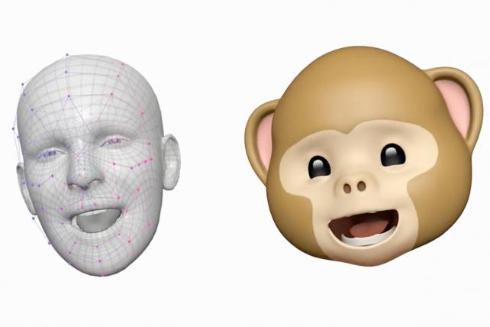
Problem Statement
Image processing:
Pixel accessing and calculating is slow due to high dimensionality, in addition, the usage of “for loops” and “if-else” statement can also slow down the coding process.
Application Fields of Image Processing:
eye-tracking, face recognition, etc.

Slide 4
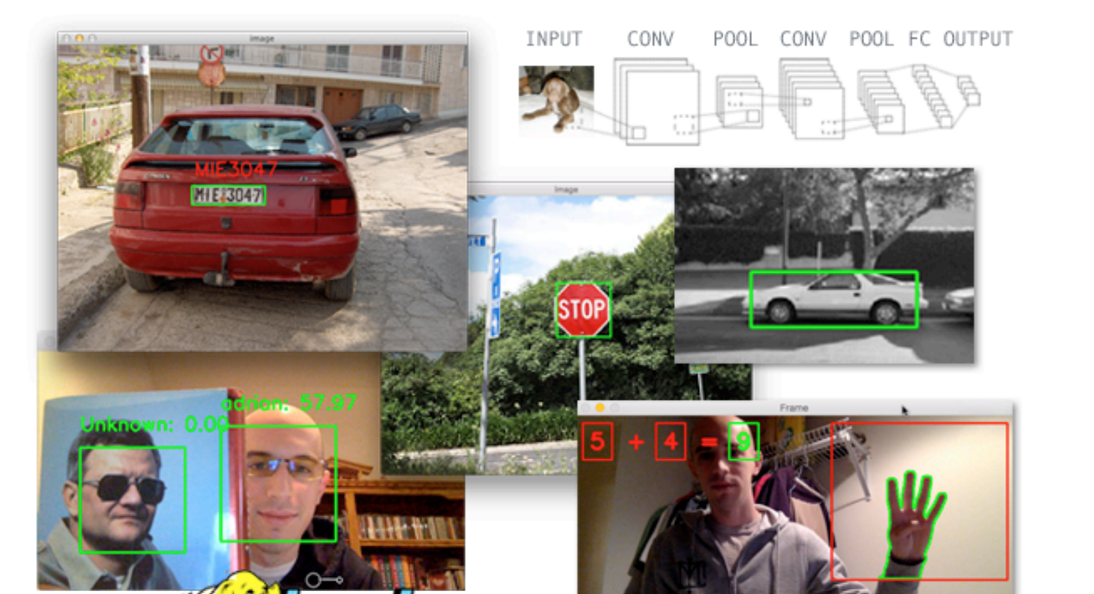
Examples: Image Recognition

Slide 5
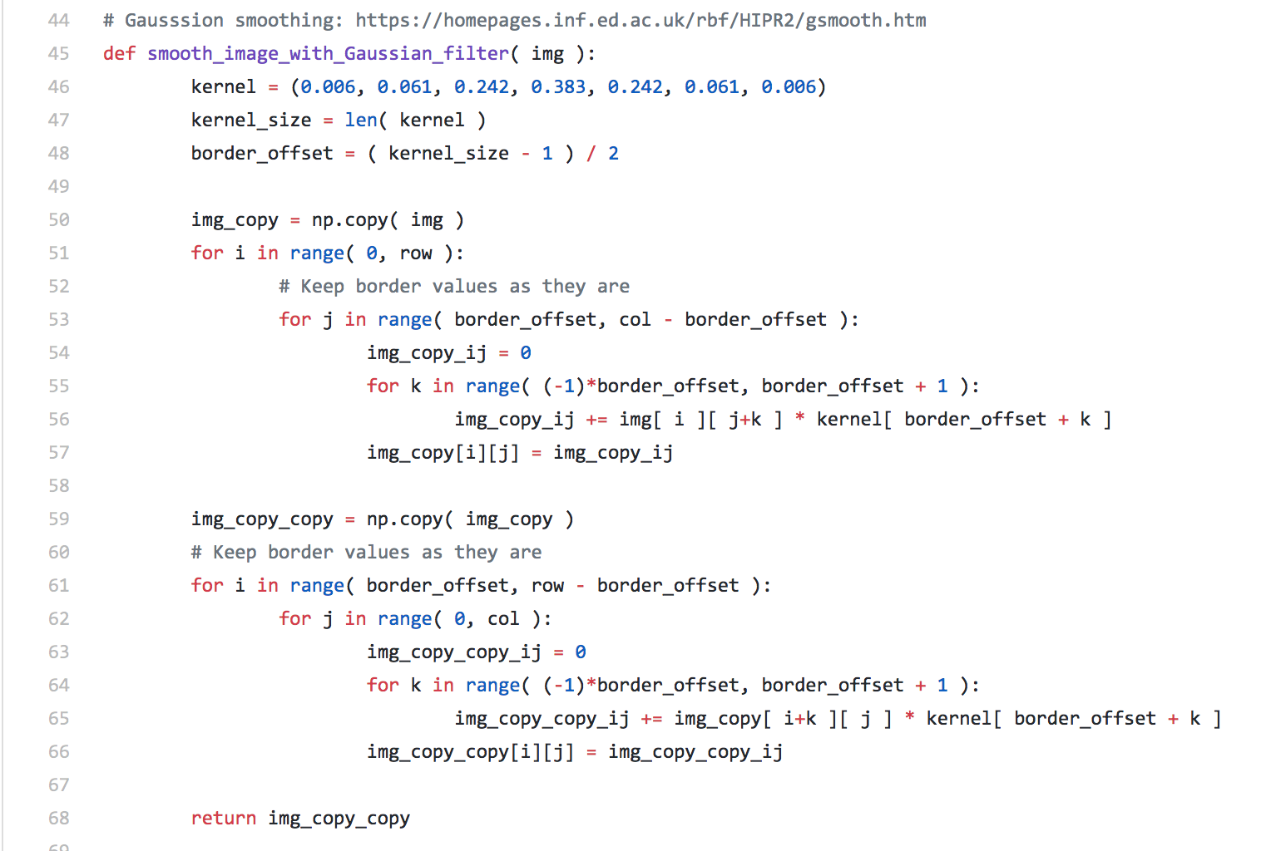
Code Example without optimization
It takes about 1.23 min to run!

Slide 6
Methodology
Vector Operation/Matrix Multiplication: recall the last homework in the heat problem
Built-in libraries:
OpenCV: built-in function like “ForEach(allows you to use all cores on your machine to access every pixel in the image)
Scikit-Image
Cython
Python optimization tricks: reduce function call overhead, etc.
Optional: OpenMP(open multi-processing), PySpark
Version Control (Github)

Slide 7
Expected Results
At least 20% faster for the core parts.
Focus on the speed instead of readability or anything else.

Slide 8
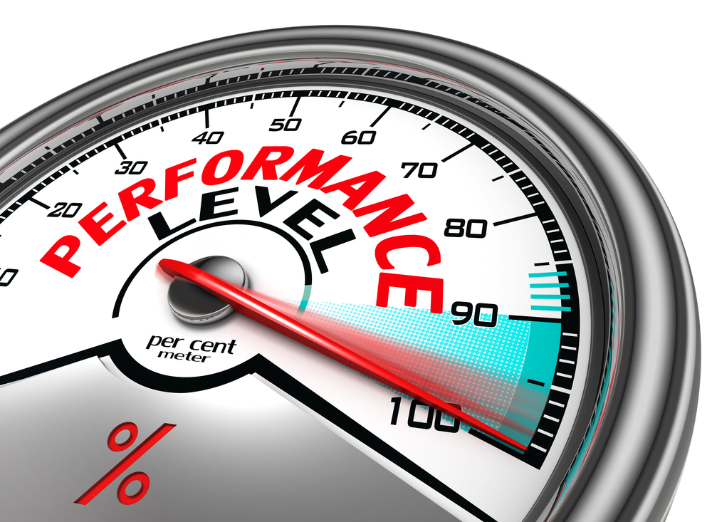
We’ll directly apply the tools we learned in class
Python Performance
Reducing function overhead
Efficient membership testing
Itertools
Numpy
Cython
Numba
Timing and profiling tools
cProfile
Prun
Julia?
Spark?

Slide 9
Schedule
Code review and analysis
Time performance
Determine areas for improvement and necessary tools
Second phase optimization
Improve upon first stage (apply more challenging techniques)
Build additional functionality for the code
Weeks 3-4
Weeks 7-8
Weeks 1-2
Weeks 5-6
First phase optimization
Implement planned optimization
Track performance, measure & document improvement
Final phase of the project
Finalize, test and measure overall optimization
Document methods, challenges, and outcomes
Prepare the final report and presentation

Slide 10

Questions?

